Slide 1

Artificial Intelligence Course
Eng. Abdulrazak A. Dirie

Slide 2
INTELLIGENT AGENTS
Chapter Two
Part One

Slide 3
INTELLIGENT AGENTS
Chapter 1 identified the concept of rational agents as central to our approach to artificial intelligence.
Our plan is to use this concept to develop a small set of design principles for building successful agents—systems that can reasonably be called intelligent

Slide 4
AGENTS AND ENVIRONMENTS
An agent is anything that can be viewed as perceiving its environment through sensors and acting upon that environment through actuators.
 | human agent | Robotic agent | software agent
sensors | eyes, ears, and other organs | cameras and infrared range finders | keystrokes, file contents, and network packets
actuators | hands, legs, vocal tract | various motors | displaying on the screen, writing files, and sending network packets

Slide 5
AGENTS AND ENVIRONMENTS
We use the term percept to refer to the agent’s perceptual inputs at any given instant
An agent’s percept sequence is the complete history of everything the agent has ever perceived.
an agent’s choice of action at any given instant can depend on the entire percept sequence observed to date, but not on anything it hasn’t perceived

Slide 6
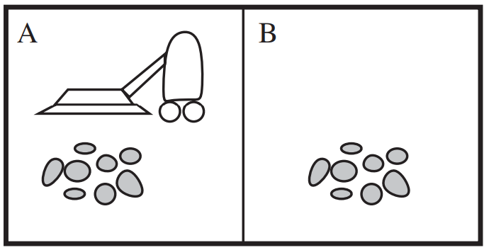
AGENTS AND ENVIRONMENTS

Slide 7
AGENTS AND ENVIRONMENTS
Mathematically speaking, we say that an agent’s behavior is described by the agent function that maps any given percept sequence to an action.
F(x) = nx
Percept sequence | Action
[A, Clean] | Right
[A, Dirty] | Suck
[A, Clean] | Left
[A, Dirty] | Suck
: | :

Slide 8
THE CONCEPT OF RATIONALITY
Good behavior is the concept of rationality.
A rational agent is one that does the right thing.
When an agent is plunked down in an environment, it generates a sequence of actions according to the percepts it receives. This sequence of actions causes the environment to go through a sequence of states. If the sequence is desirable, then the agent has performed well. This notion of desirability is captured by a performance measure that evaluates any given sequence of environment states.

Slide 9
Rationality
What is rational at any given time depends on four things:
The performance measure that defines the criterion of success.
The agent’s prior knowledge of the environment.
The actions that the agent can perform.
The agent’s percept sequence to date.
A rational agent is:
For each possible percept sequence, a rational agent should select an action that is expected to maximize its performance measure, given the evidence provided by the percept sequence and whatever built-in knowledge the agent has.

Slide 10
Omniscience, Learning, and Autonomy
distinguish between rationality and omniscience.
Rationality maximizes expected performance, while perfection maximizes actual performance.
Doing actions in order to modify future percepts—sometimes called information gathering.
Learn: to learn as much as possible from what it perceives.
Autonomy : a rational agent should be autonomous—it should learn what it can to compensate for partial or incorrect prior knowledge.

Slide 11
THE NATURE OF ENVIRONMENTS
We must think about task environments, are essentially the “problems” to which rational agents are the “solutions”.
We call this the PEAS (Performance, Environment, Actuators, Sensors) description.
We will discuss each element in more detail.
Agent Type | Performance Measure | Environment | Actuators | Sensors
Taxi driver | Safe, fast, legal, comfortable trip, maximize profits | Roads, other traffic, pedestrians, customers | Steering, accelerator, brake, signal, horn, display | Cameras, sonar, speedometer, GPS, odometer, accelerometer, engine sensors, keyboard

Slide 12
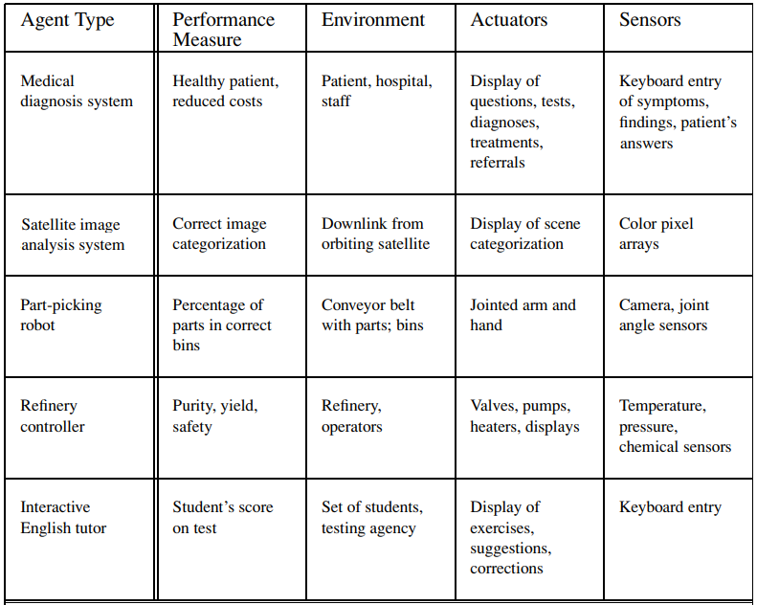

Slide 13
Properties of task environments
Fully observable vs. partially observable: A task environment is effectively fully observable if the sensors detect all aspects that are relevant to the choice of action;
Single agent vs. multiagent.
Deterministic vs. stochastic.
Episodic vs. sequential.
Static vs. dynamic.
Discrete vs. continuous.
Known vs. unknown.

Slide 14
END

